Slide 1
Algorithms for the Visualization and Simulation of Mobile Ad Hoc and Cognitive Networks
Dan Hennessey

Slide 2
Outline
Introduction
Network Visualization
Graph Simplification
Cognitive Network GPU Algorithms.
Conclusions

Slide 3
Introduction
Give a brief into about the topics being discussed.
Use the abstract as a guide for this section

Slide 4
Algorithms for Mobile Ad Hoc Network Visualization
Chapter 1

Slide 5
Mobile Ad Hoc Networks
Cover the motivation behind the visualization efforts
Use the related work section to explain lack of useful visualization techniques
No uses of digital terrain for improving the visual representation of MANETs

Slide 6
Signal Radiation Patterns
Explain the signal radiation patterns
Explain what they represent and why they are useful to visualize
Possibly use the equations to help with this

Slide 7
Radiation Patterns
Fully known channel state
Highly unstable channel state

Slide 8
Radiation Patterns with Regions of Acceptable SINR
Fully known channel state
Highly unstable channel state

Slide 9
Digital Terrain
Motivate use of digital terrain
Uses in both simulation and visualization
Needed to develop a library to abstract the specifics of file formats.

Slide 10
Terrain Library
Don’t cover entire design of the terrain library
Cover specific features
Lake detection
Horizontal cut profiles
How it removes file boundaries
Its abstract way of referencing terrain data

Slide 11
Terrain Library

Slide 12
Terrain Color Maps

Slide 13
2D Terrain Visualization
Flow Graph
Physical Graph

Slide 14
3D Terrain Visualization

Slide 15
3D Terrain Visualization

Slide 16
Conclusion
Brief summary of conclusions
Use conclusion summary from paper as guide

Slide 17
A Simplification Algorithm for Visualizing the Structure of Complex Graphs
Chapter 2

Slide 18

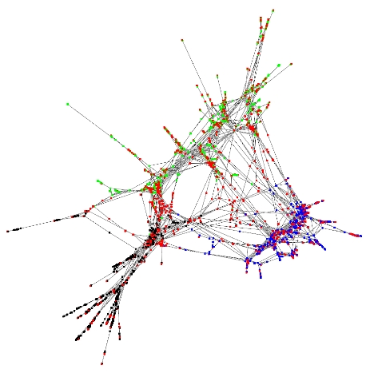
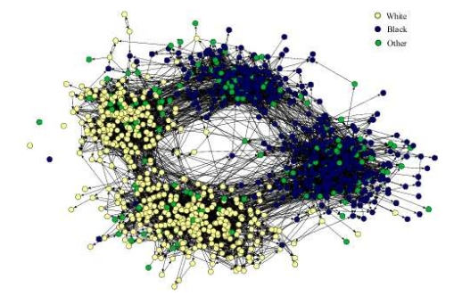
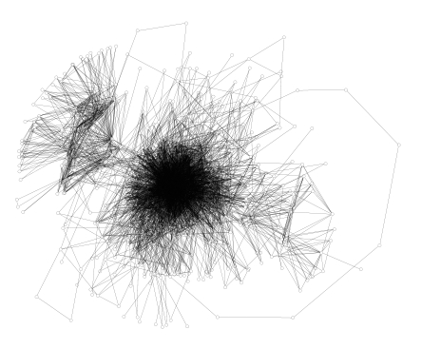
Notes:
18

Slide 19

Node weighting
N-ring Neighbors
Number of Shortest Paths
Eccentricity
Shortest Distance to a Center Node
Shortest Distance to a Leaf Node
Node Pruning
Connectivity Preservation
Iterative Pruning
Notes:
19

Slide 20

3 Performance Criteria
Wide range of weight values
Even distribution of weights
Meaningful visual representation
Notes:
20

Slide 21

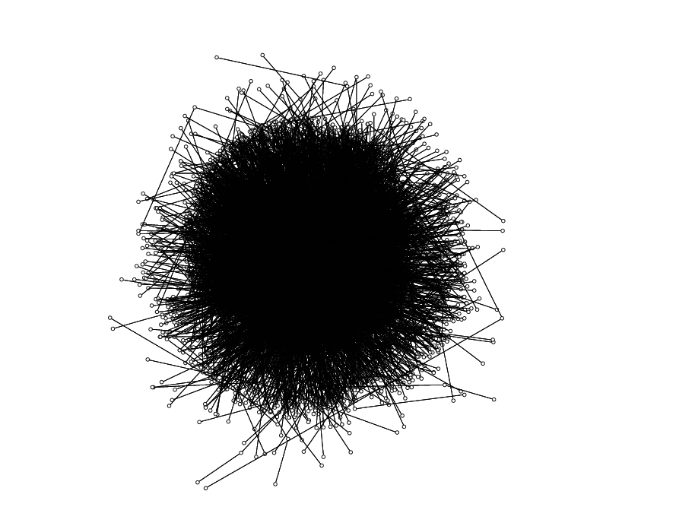
4500 Nodes
15308 Edges
Notes:
21

Slide 22

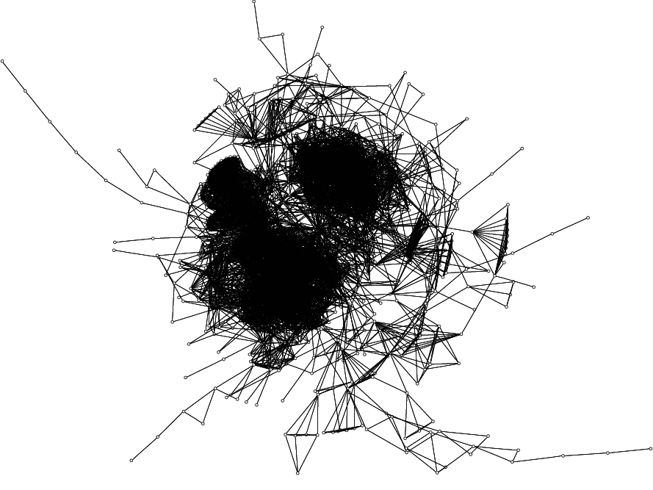
1025 Nodes
15430 Edges
Notes:
22

Slide 23

Notes:
23

Slide 24

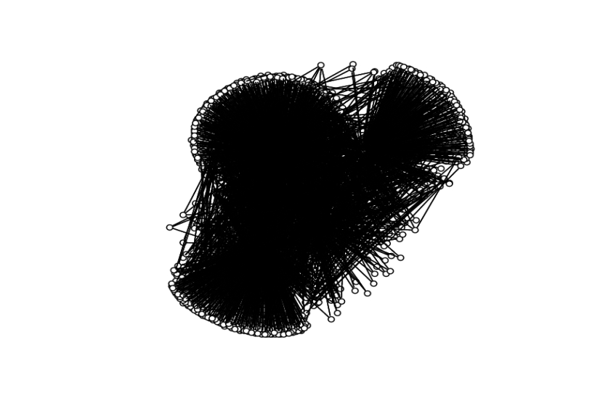
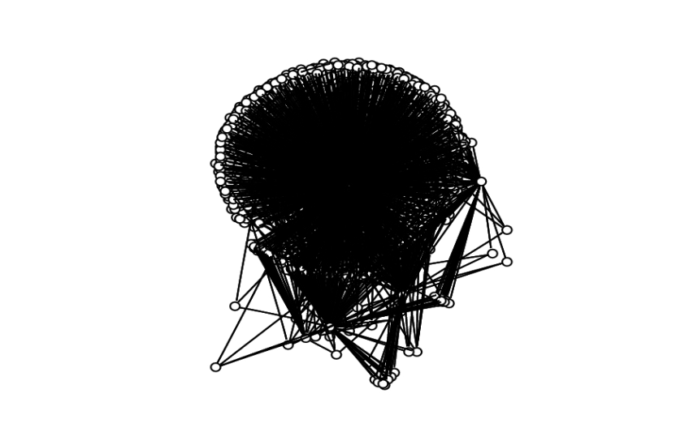
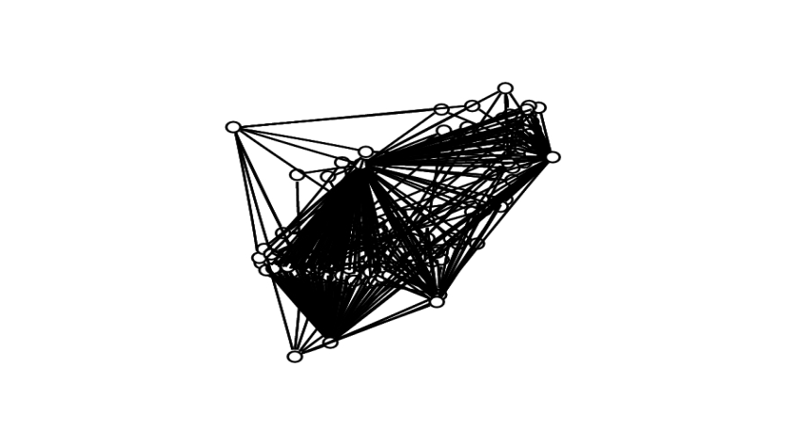
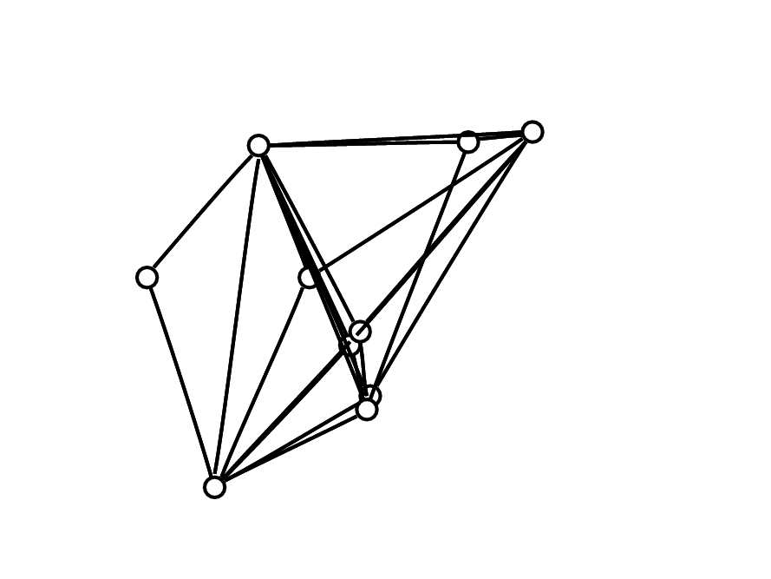
T = 300
T = 700
T = 1200
T = 1800
Notes:
24

Slide 25

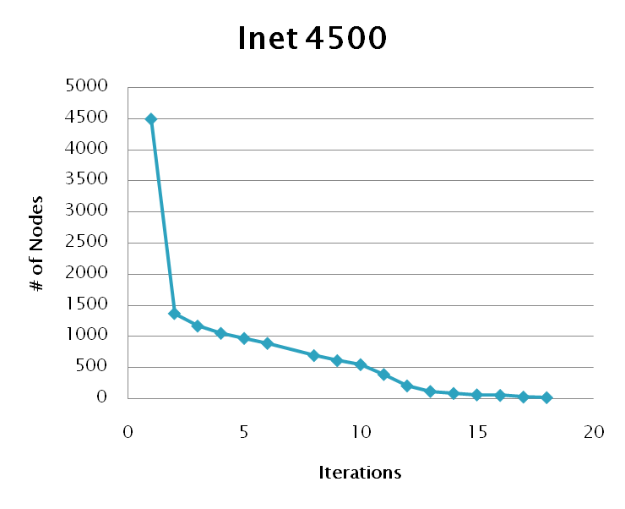
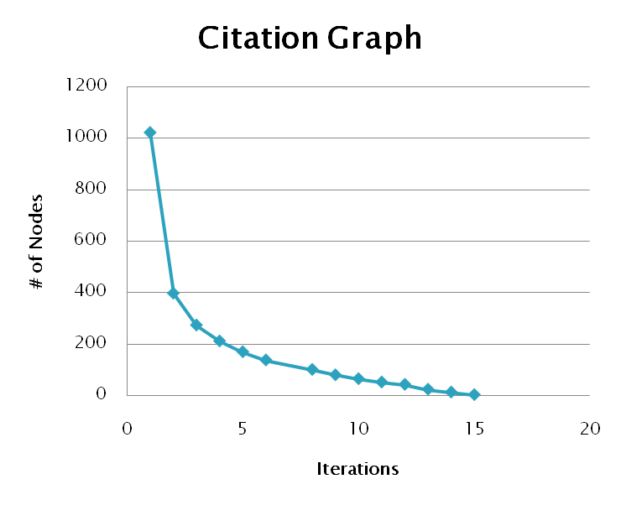
Notes:
25

Slide 26

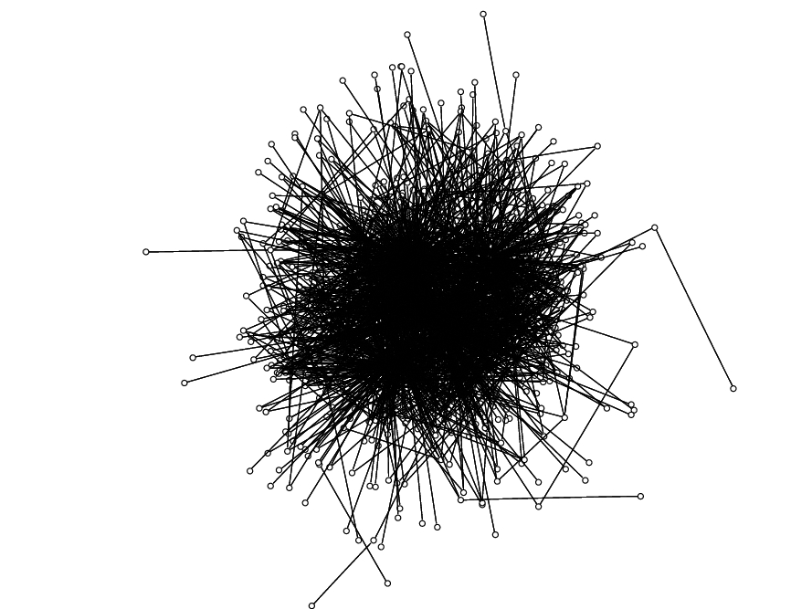
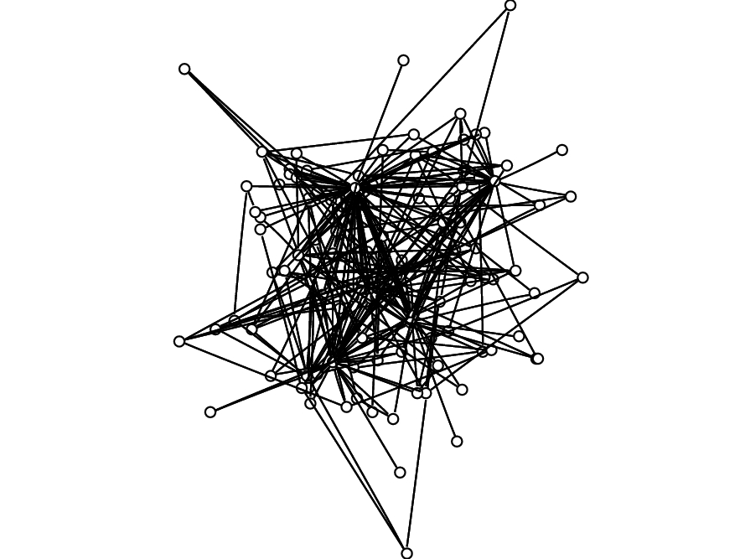
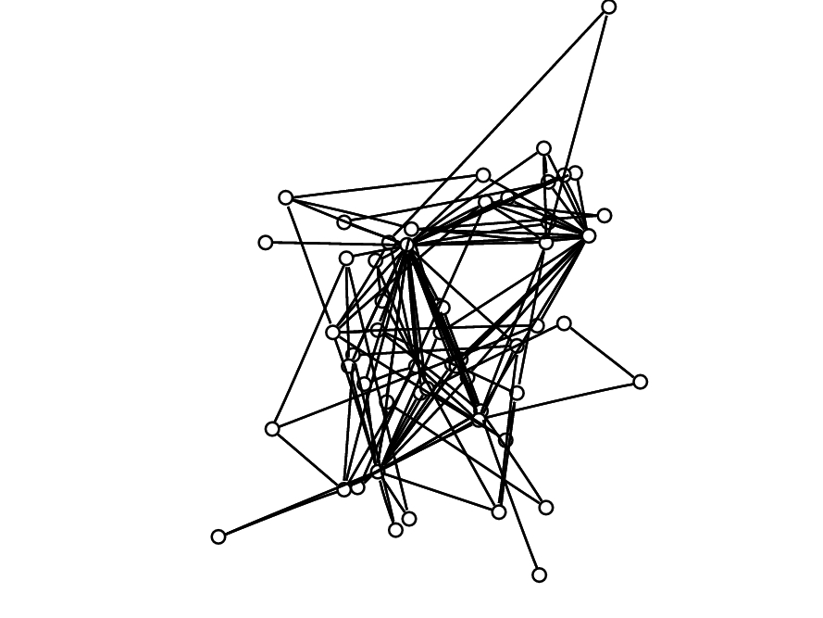
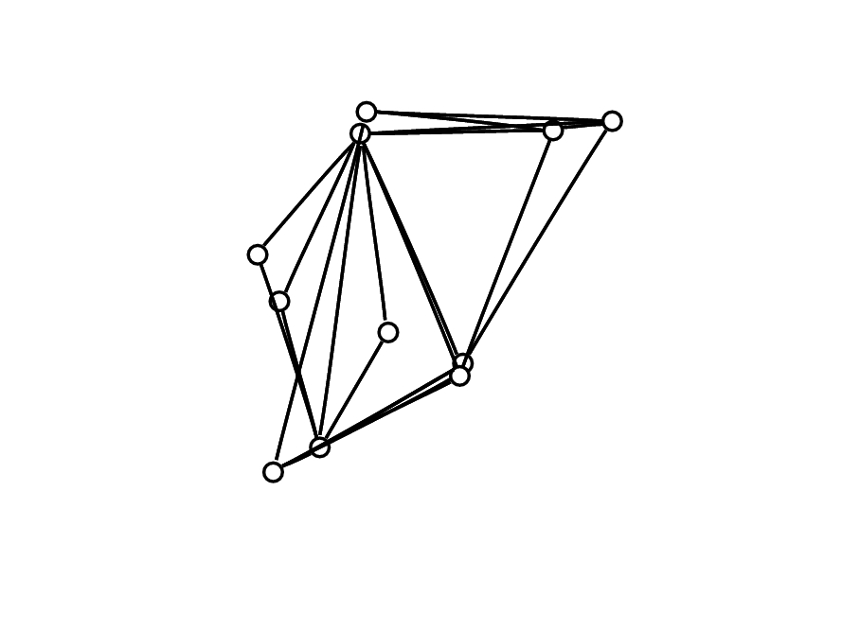
T = 1000
T = 40000
T = 100000
T = 645000
Notes:
26

Slide 27

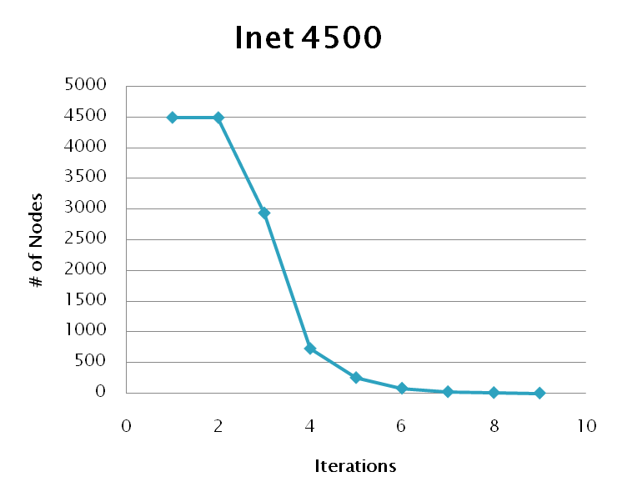
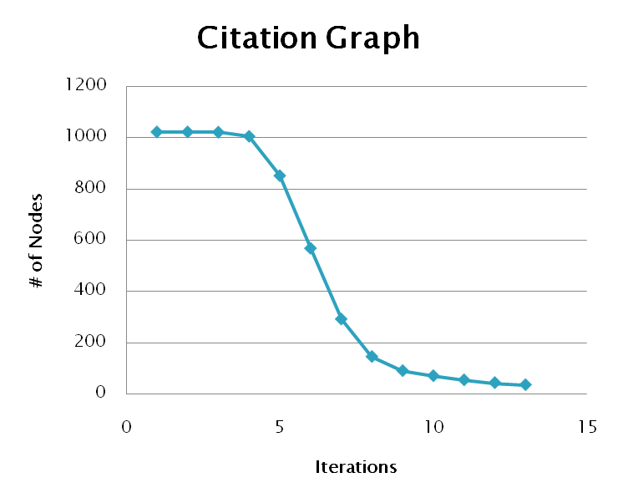
Notes:
27

Slide 28

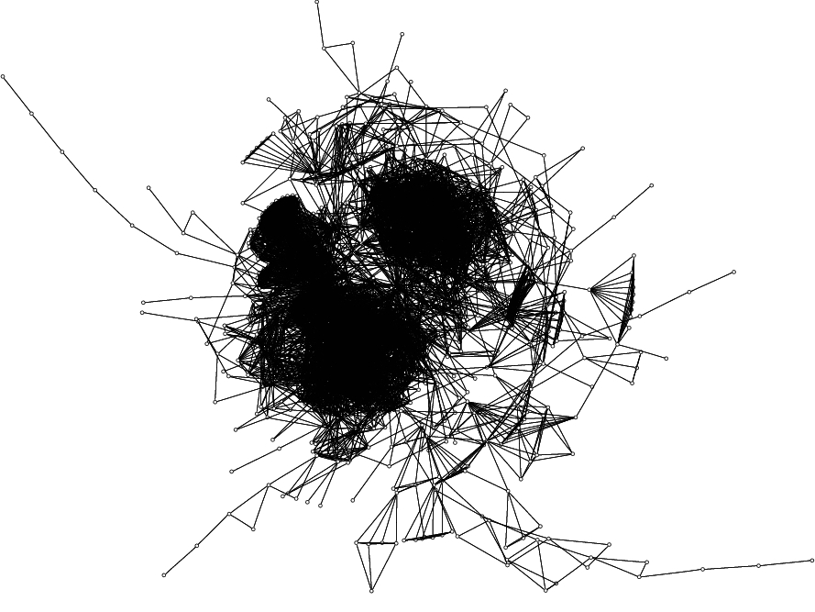
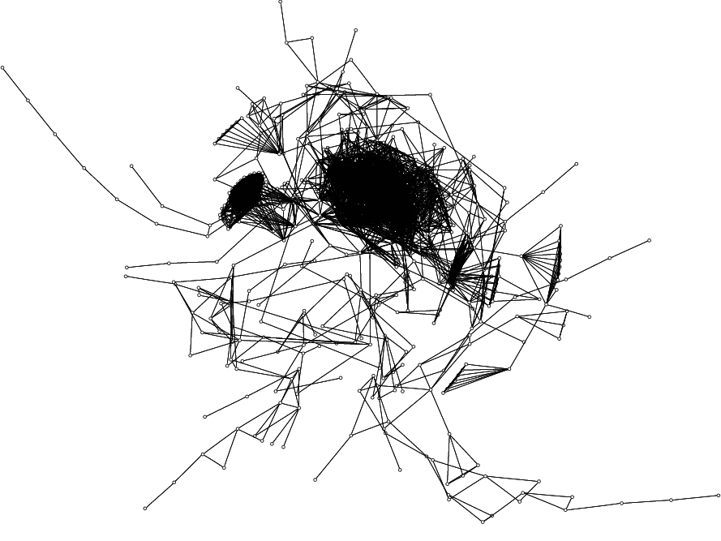
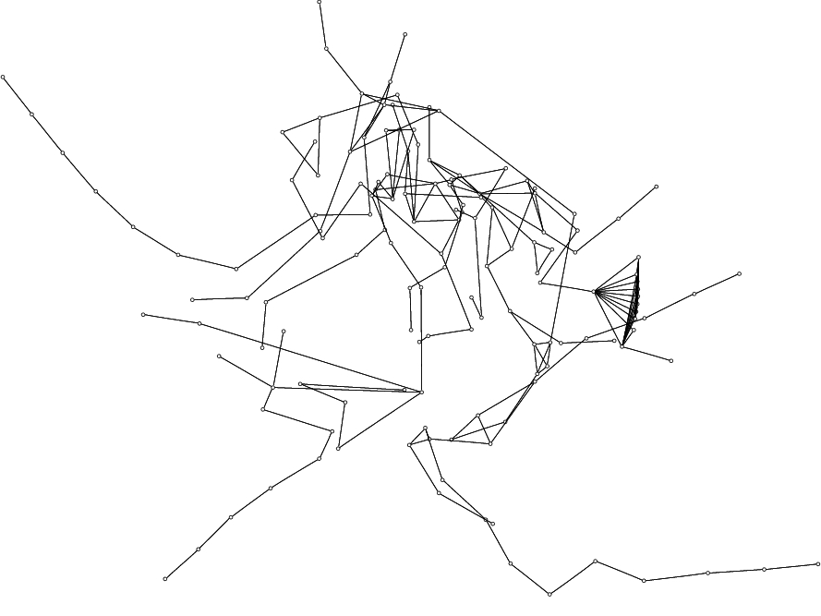
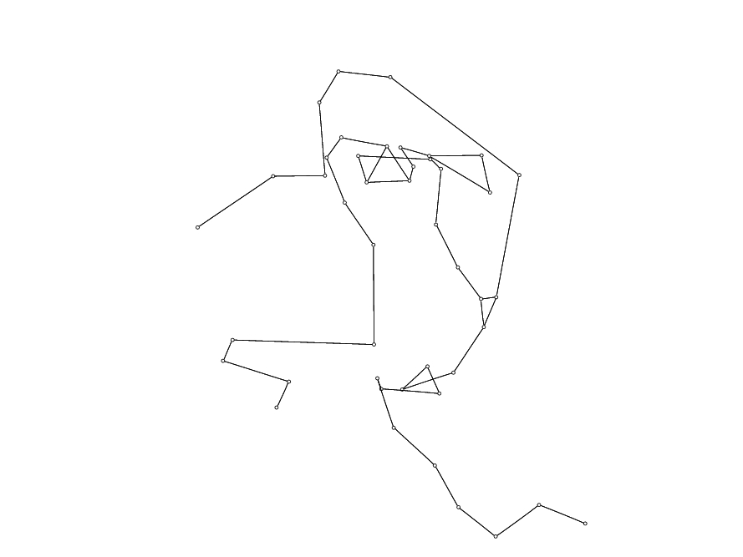
T = 10
T = 13
T = 15
T = 19
28
Notes:
28

Slide 29

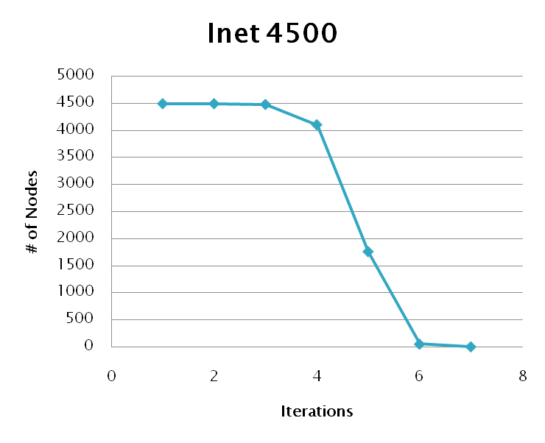
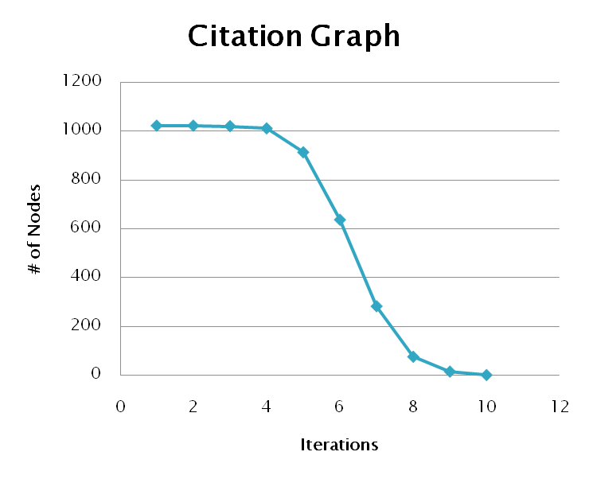
Notes:
29

Slide 30

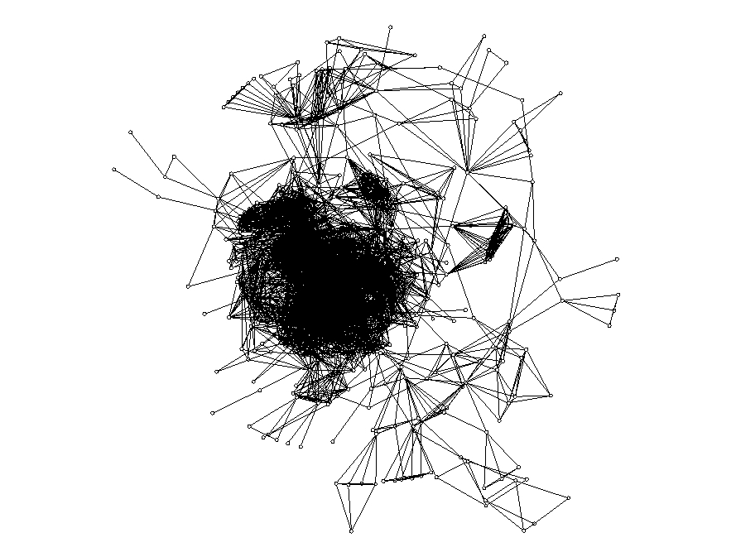
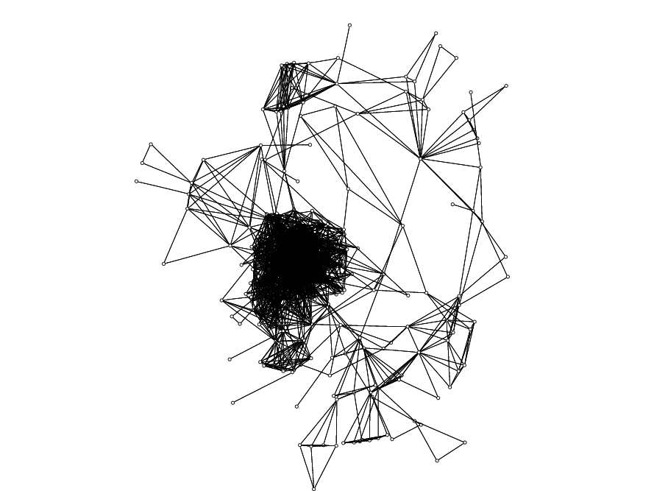
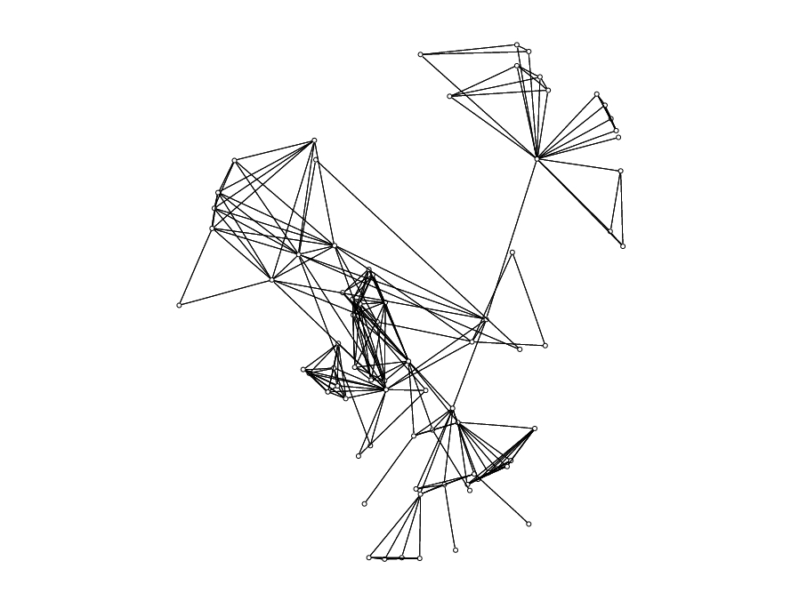
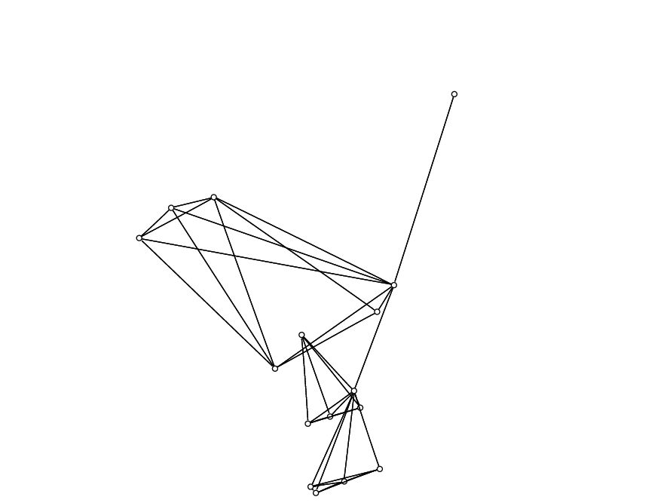
T = 5
T = 6
T = 7
T = 8
Notes:
30

Slide 31

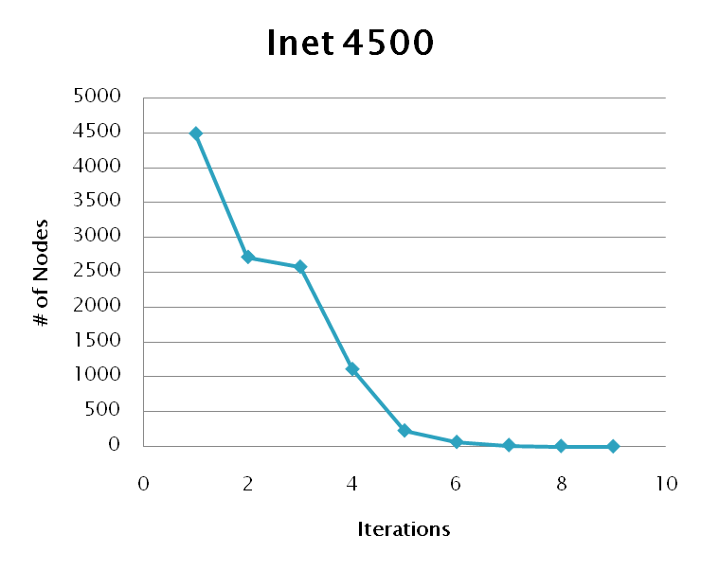
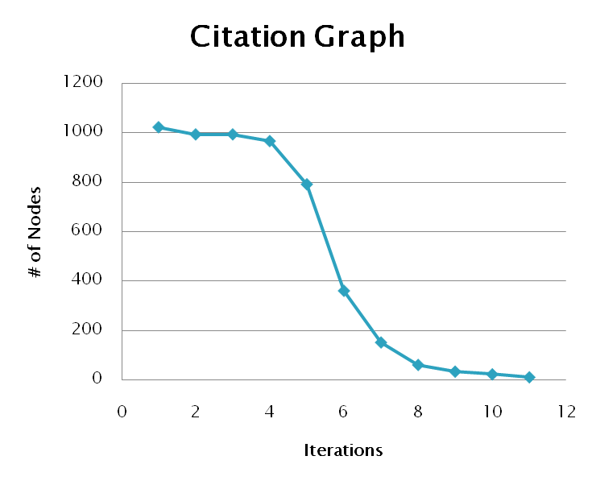
Notes:
31

Slide 32

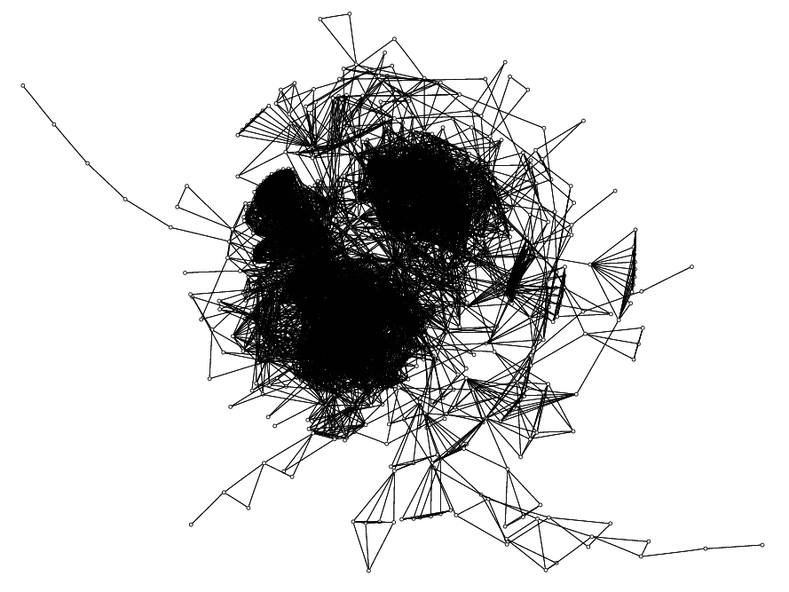
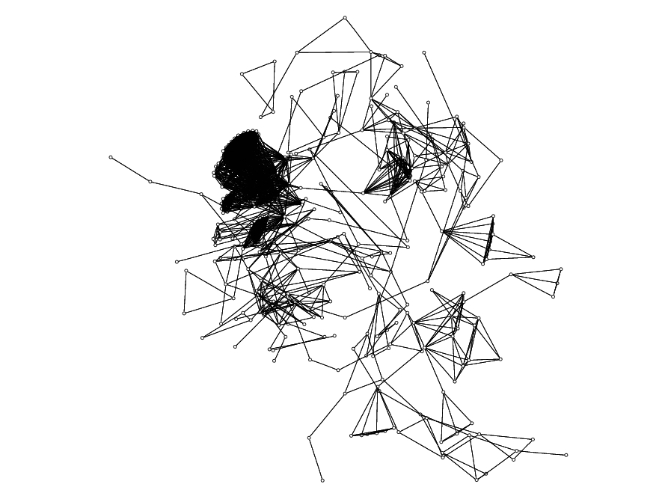
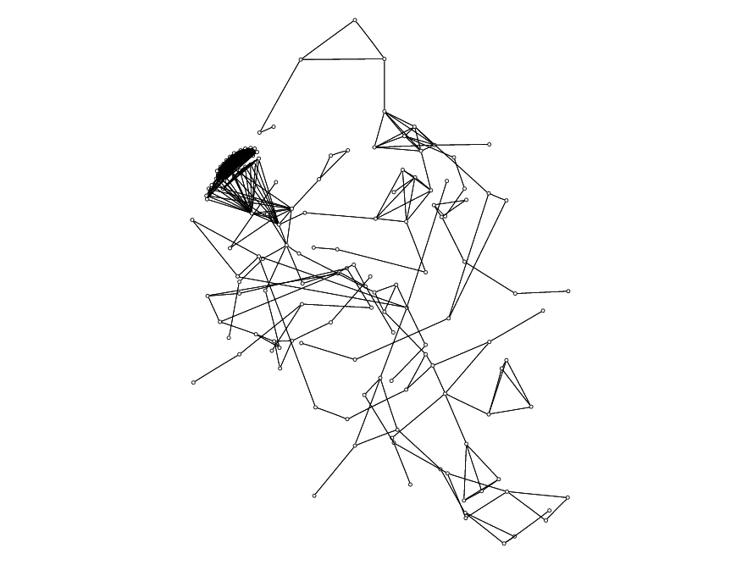
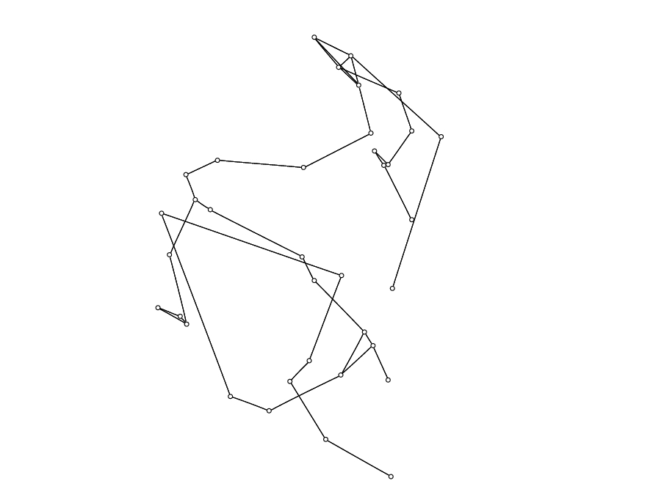
T = 2
T = 5
T = 6
T = 9
Notes:
32

Slide 33

Proposed Method
Shown several weighting metrics
Evaluated performance
Applied metrics to several graphs
Future Work
Define further metrics
Consider more graph types
Notes:
33

Slide 34
GPU Based Algorithms for Spectrum Sensing in Cognitive Radio Networks
Chapter 3

Slide 35
Cognitive Networking & Spectrum Sensing
Background behind cognitive networking and spectrum sensing.
Motivation for improving performance
Use intro and related work from thesis as guide

Slide 36
Why use the GPU?
Discuss hardware architecture differences
How do these differences improve performance
What other factors improve performance

Slide 37
Why use the GPU?

Slide 38
Application to Cognitive Networking

Slide 39
Energy Detection
Detects weak, deterministic signals in AWG noise
Energy detectors required to be suboptimal
Optimal detectors require matched filters
Requires a priori knowledge of data
Suboptimal detectors include
Low-pass filter and square law detector
Periodogram based detector

Slide 40
Energy Detection Periodogram Based Detection
Welch method of averaged periodograms
Creates M segments with D overlap
Hamming window applied to each segment
Periodogram of each segment is computed
All segments are averaged together
Con: Reduces the resolution of the resulting estimates.

Slide 41
Cyclostationary Spectral Analysis
Distinguishes between
Modulated signals
Interference
Noise
Estimates correlation between spectral components of the signal.
Described by the Spectral Correlation Density (SCD) Function.

Slide 42
FFT Accumulation Method
3 Steps to the algorithm
Compute Complex Demodulates (Eq 2)
Compute Product sequences (Eq 1)
Reorder data into cycle frequency vs. frequency
(Eq 1) SCD Function
(Eq 2) Complex Demodulates

Slide 43
Energy Detection Results
Matlab Timings (msec)
M | 512 | 1024 | 2048 | 4096
25% Overlap | 15.987 | 10.196 | 11.523 | 8.656
50% Overlap | 22.818 | 14.17 | 26.37 | 10.817
75% Overlap | 42.717 | 25.284 | 26.428 | 17.409
CUDA Timings (msec)
M | 512 | 1024 | 2048 | 4096
25% Overlap | 1.49 | 1.494 | 1.543 | 1.69
50% Overlap | 1.465 | 1.459 | 1.527 | 1.693
75% Overlap | 1.457 | 1.462 | 1.555 | 1.72

Slide 44
FFT Accumulation Method Results
Matlab Timings (msec)
N | 1024 | 2048 | 4096 | 8192
Channelize | 0.253 | 1.312 | 1.366 | 1.133
Window | 1.042 | 1.577 | 4.433 | 13.533
Np-point FFTs | 0.493 | 0.903 | 1.333 | 2.233
Down Convert | 2.370 | 4.777 | 10.066 | 17.4
Product Seq | 9.876 | 41.413 | 166 | 658.5
P-point FFTs | 13.848 | 54.107 | 222.3 | 882.566
SCD | 41.45 | 177.039 | 780.566 | 3144.133
Total | 69.432 | 280.899 | 1186.133 | 4719.567

Slide 45
FFT Accumulation Method Results
CUDA Timings (msec)
N | 1024 | 2048 | 4096 | 8192
Mem Transfer | 0.564 | 0.544 | 0.537 | 0.58
Channelize | 1.127 | 0.569 | 0.765 | 0.732
Window | 0.51 | 0.404 | 1.238 | 3.343
Np-point FFTs | 0.49 | 0.284 | 0.591 | 0.672
Down Convert | 0.671 | 0.382 | 0.777 | 0.841
Product Seq | 1.475 | 4.067 | 14.992 | 56.338
P-point FFTs | 1.327 | 3.537 | 13.886 | 52.331
SCD | 0.826 | 1.386 | 6.19 | 34.603
Total | 6.993 | 11.179 | 38.98 | 149.445

Slide 46
Conclusion

Slide 47
Final Conclusions

Slide 48
Acknowledgements
Dr. Chaomei Chen of Drexel University’s iSchool for providing the citation graph data set.
Alex Fridman of Drexel University’s ECE Department for OMAN research support.
Boris Shishkin of Drexel University’s ECE Department for cognitive networking research support.
U.S Army Communications Electronic Research Development and Engineering Center (CERDEC) under contract # DAAB-07-01-9-L504

